Slide 1
Data Structures
12. Binary Search Tree

Slide 2
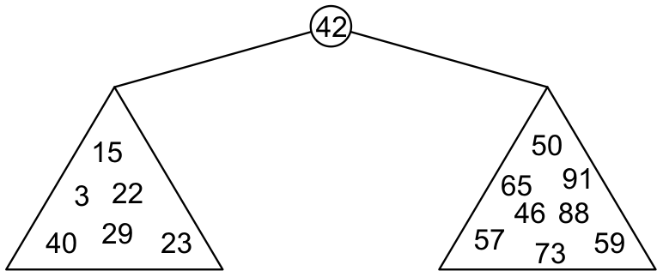
Binary Search Tree (BST)
With a binary tree, we can dictate an order on the two children
Binary Search Tree (BST) defines the following order:
All elements in the left sub-tree to be less than the element stored in the root node, and
All elements in the right sub-tree to be greater than the element in the root object
subtrees will themselves be binary search trees

Slide 3
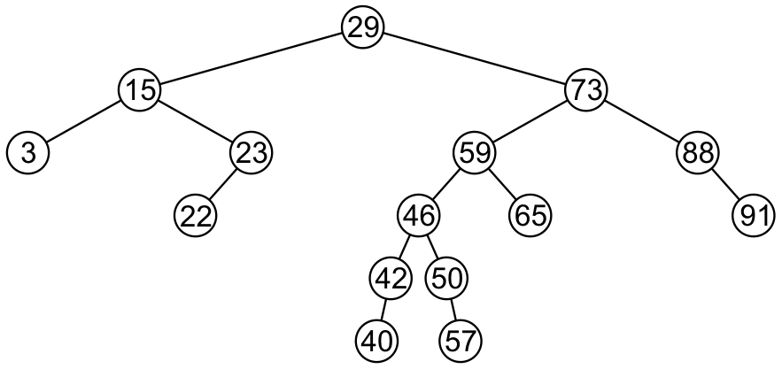
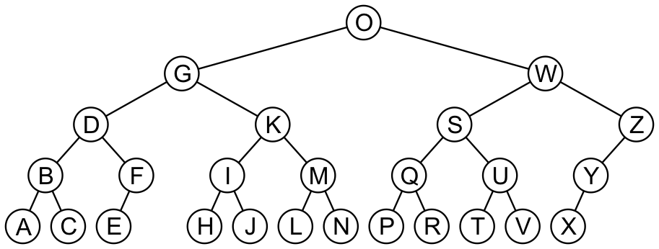
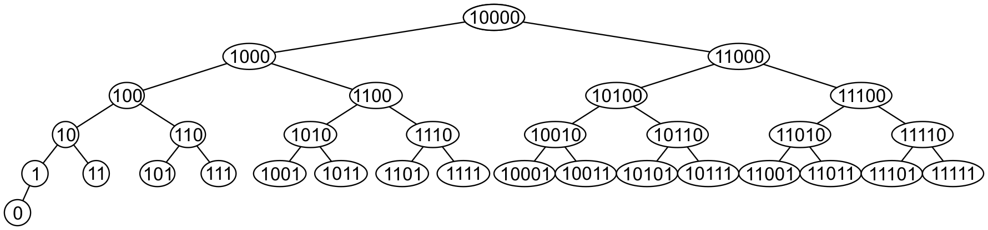
Binary Search Tree (BST) – Example (1)

Slide 4
Binary Search Tree (BST) – Example (2)
5
10
2
45
10
5
30
5
45
30
2
25
45
10
2
25
30
BST
25
Not BST
BST

Slide 5
BST Operations
Many operations one can perform on a binary search tree
Creating a binary search tree
Finding a node in a binary search tree
Inserting a node into a binary search tree
Deleting a node in a binary search tree
Traversing a binary search tree
In the following, we will examine the algorithms and examples for all of the above operations

Slide 6
Creating BST
A simple class that implements a binary tree to store integer values
A class called IntBinaryTree
Node of binary search tree
struct TreeNode
{
int value;
TreeNode *left;
TreeNode *right;
};

Slide 7
Creating BST – Class Definition
class IntBinaryTree { private: TreeNode *root; // Pointer to the root of BST
void destroySubTree(TreeNode *); //Recursively delete all tree nodes
void deleteNode(int, TreeNode *&); void makeDeletion(TreeNode *&); void displayInOrder(TreeNode *); void displayPreOrder(TreeNode *); void displayPostOrder(TreeNode *);
public:
IntBinaryTree() { root = NULL; } ~IntBinaryTree() { destroySubTree(root); } void insertNode(int); bool find(int); void remove(int); { deleteNode( num, root); } void showNodesInOrder() { displayInOrder(root); } void showNodesPreOrder() { displayPreOrder(root); } void showNodesPostOrder() { displayPostOrder(root); } };

Slide 8
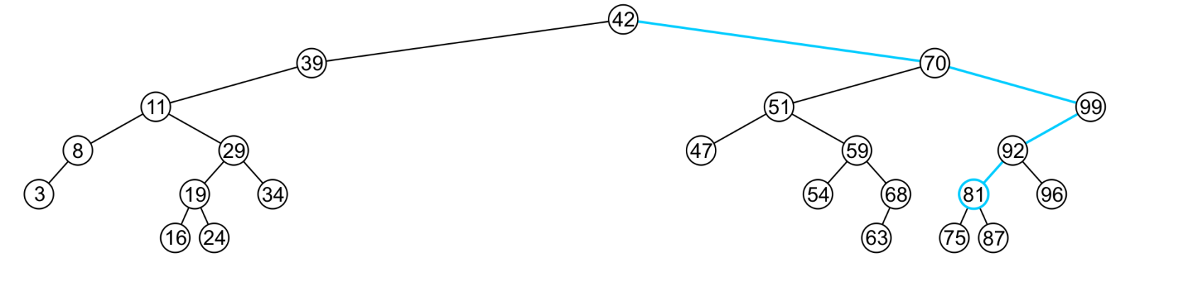
Finding a Node in BST
Recall that a BST has the following key property (invariant):
Smaller values in left sub-tree
Larger values in right sub-tree
For example: find (81)
Returns true if found

Slide 9
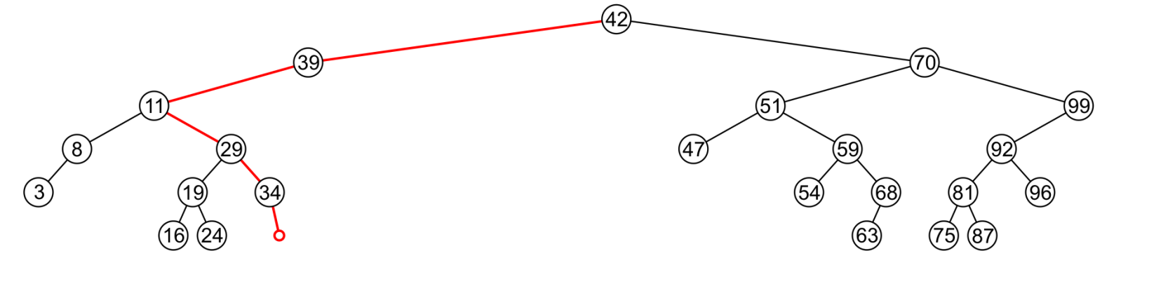
Finding a Node in BST
Recall that a BST has the following key property (invariant):
Smaller values in left sub-tree
Larger values in right sub-tree
For example: find (36)
Returns false if not found

Slide 10
Finding a Node in BST
Example: find(2)
root
10
10 > 2, left
5 > 2, left
2 = 2, found
5
30
2
25
45

Slide 11
Finding a Node in BST
Example: find(25)
root
5
5 < 25, right
45 > 25, left
30 > 25, left
10 < 25, right
25 = 25, found
2
45
30
10
25

Slide 12
Finding a Node in BST – Implementation
bool IntBinaryTree::find(int num){
// The function starts from the root
TreeNode *nodePtr = root;
while (nodePtr) {
if (nodePtr->value == num)
return true; // value is found
else if (num < nodePtr->value)
nodePtr = nodePtr->left;
else
nodePtr = nodePtr->right;
}
return false; // value not found
}
10
10 < 25, right
30 > 25, left
25 = 25, found
5
30
2
25
45

Slide 13
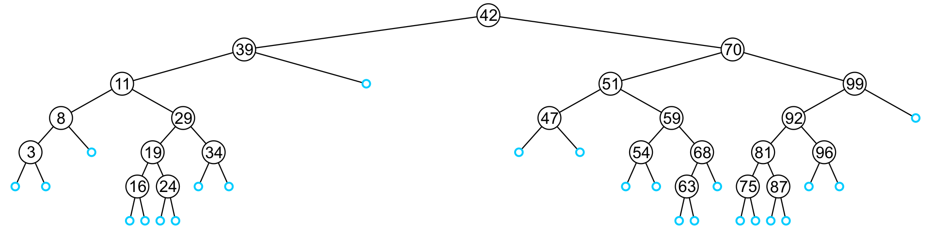
Inserting a Node in BST
An insertion will be performed at a leaf node
Any empty node is a possible location for an insertion
Values which may be inserted at any empty node depend on the surrounding nodes

Slide 14
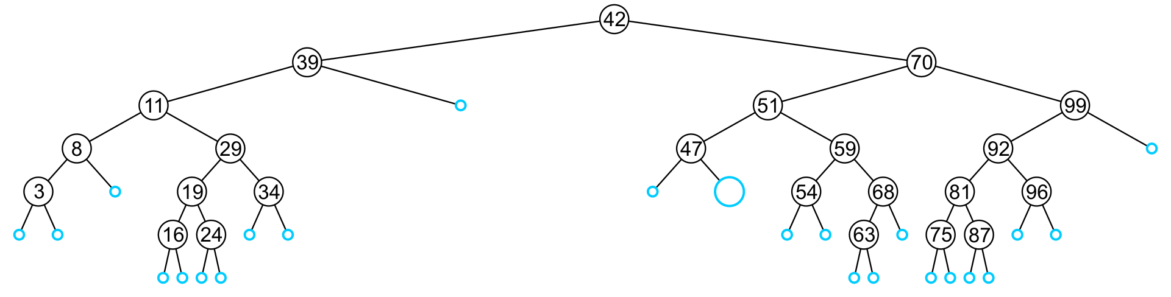
Inserting a Node in BST
Which values can be held by empty node?
This node may hold 48, 49, or 50

Slide 15
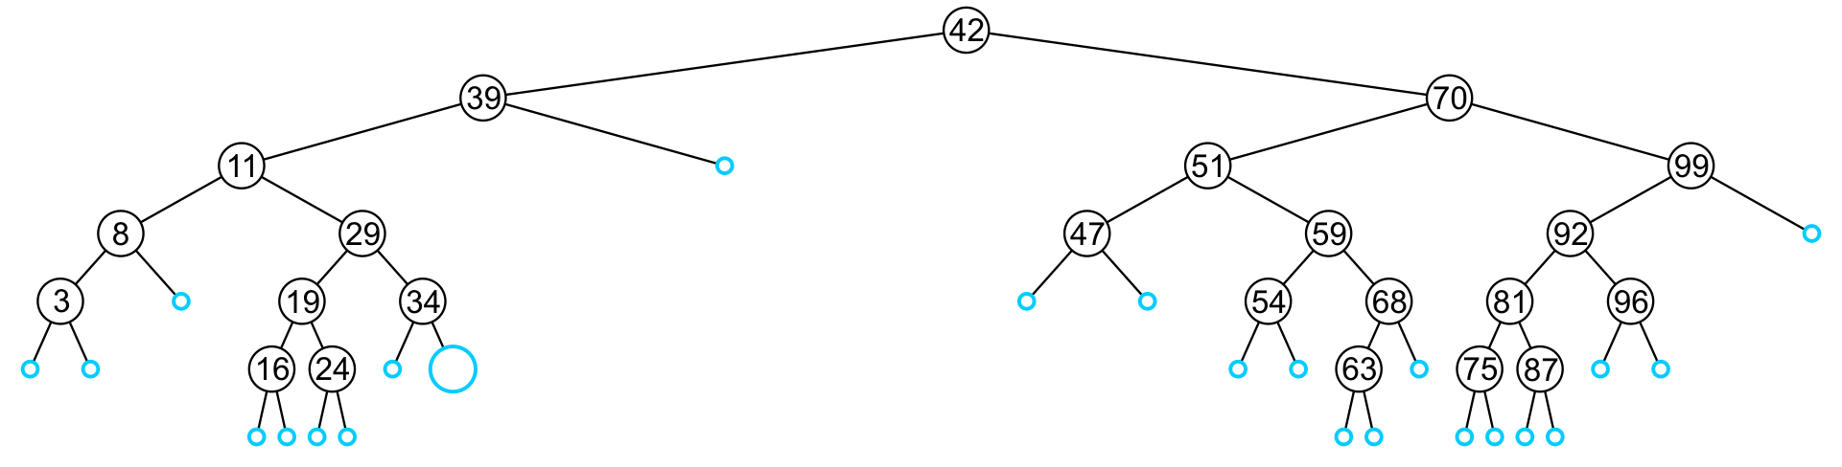
Inserting a Node in BST
Which values can be held by empty node?
This node may hold 35, 36, 37 or 38

Slide 16
Inserting a Node in BST – Algorithm
Like find, algorithm will step through the tree
If algorithm find the object already in the tree, it will return
The object is already in the binary search tree (no duplicates)
Otherwise, algorithm will arrive at an empty node
The object will be inserted into that location
Why no duplicates?
In reality, it is seldom the case where duplicate elements in a BST must be stored as separate entities

Slide 17
Inserting a Node in BST – Example
insertNode(20)
10
10 < 20, right
30 > 20, left
25 > 20, left
Insert 20 on left
5
30
2
25
45
20

Slide 18
Inserting a Node in BST – Implementation
void IntBinaryTree::insertNode(int num) { TreeNode *newNode, *nodePtr; // Pointer to create new node & traverse tree
newNode = new TreeNode; // Create a new node newNode->value = num; newNode->left = newNode->right = NULL;
if (!root) root = newNode; // If tree is empty.
else { // Tree is not empty nodePtr = root;
while (nodePtr != NULL) {
if (num < nodePtr->value) { // Left subtree
if (nodePtr->left) { nodePtr = nodePtr->left; } else { nodePtr->left = newNode; break; } }
else if (num > nodePtr->value) { // Right subtree
if (nodePtr->right) nodePtr = nodePtr->right; else { nodePtr->right = newNode; break; } } else { cout << "Duplicate value found in tree.\n"; break; } }
}
}

Slide 19
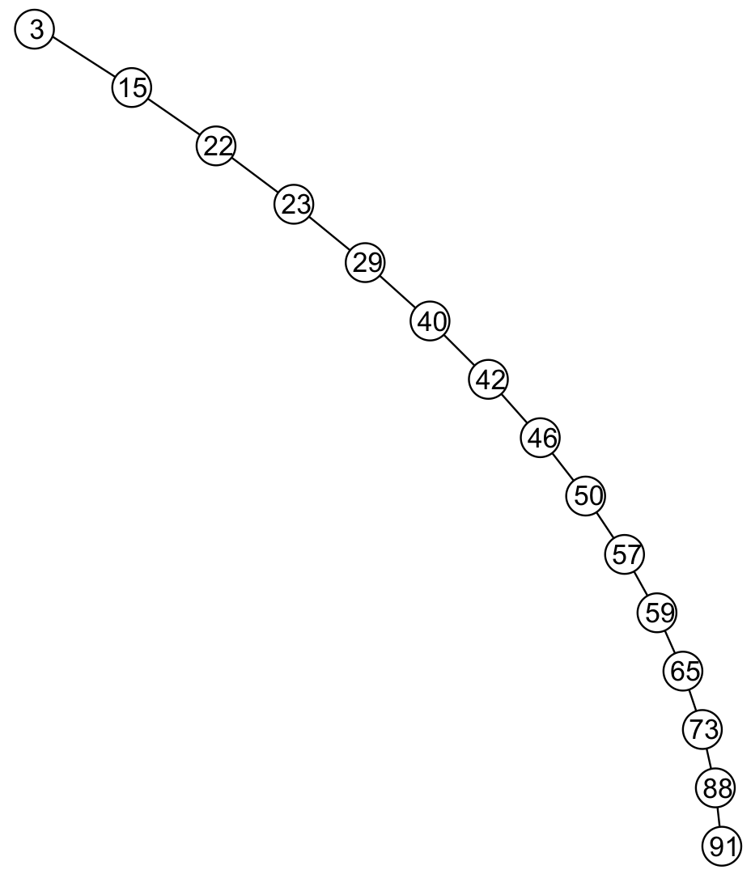
Inserting a Node in BST – Observation (1)
Insertion may unbalance the tree
It is possible to construct degenerate BST
The example is equivalent to a linked list

Slide 20
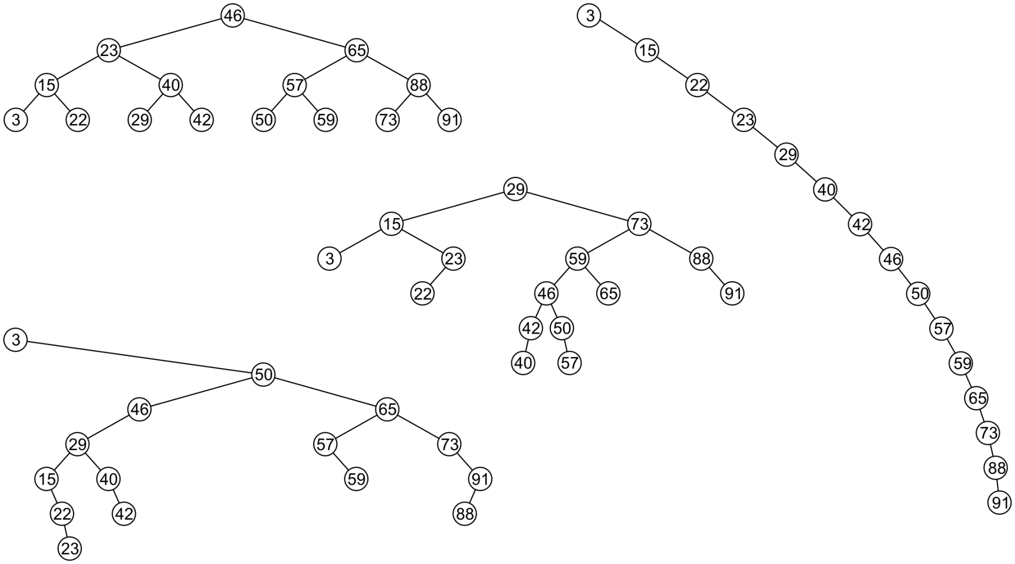
Inserting a Node in BST – Observation (2)
All these binary search trees store the same data
Resultant tree depends on the order in which the values are inserted

Slide 21
Using BST (1)
// This program builds a binary tree with 5 nodes. // The SearchNode function determines if the // value 3 is in the tree. #include <iostream.h> #include "IntBinaryTree.h“ void main(void) { IntBinaryTree tree; cout << "Inserting nodes.\n"; tree.insertNode(5); tree.insertNode(8); tree.insertNode(3); tree.insertNode(12); tree.insertNode(9);
if (tree.find(3)) cout << "3 is found in the tree.\n"; else cout << "3 was not found in the tree.\n"; }
Output:
Inserting nodes. 3 is found in the tree.

Slide 22
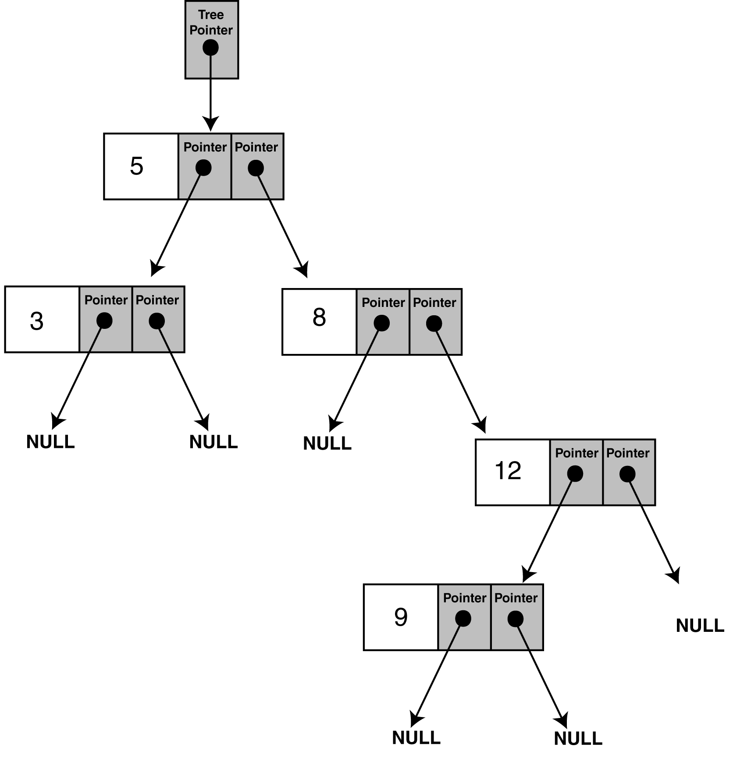
Using BST (2)
Structure of binary tree built by the program

Slide 23
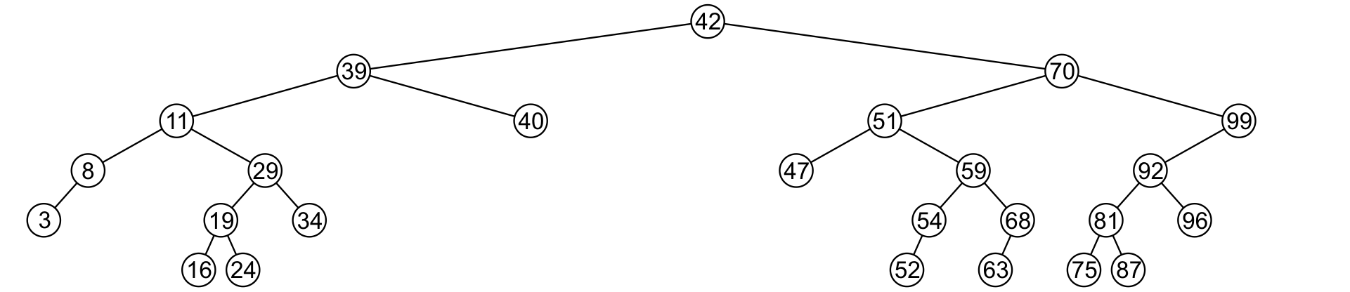
Deleting a Node
A node being erased is not always going to be a leaf node
There are three possible scenarios:
The node is a leaf node,
It has exactly one child, or
It has two children (it is a full node)

Slide 24
Deleting a Node – Leaf Node
Deleting a leaf node is easy
Find its parent
Set the child pointer that links to it to NULL
Free the node’s memory
Consider deleting node containing 25
10
10
10 < 25, right
30 > 25, left
25 = 25, delete
5
30
5
30
2
25
45
2
45

Slide 25
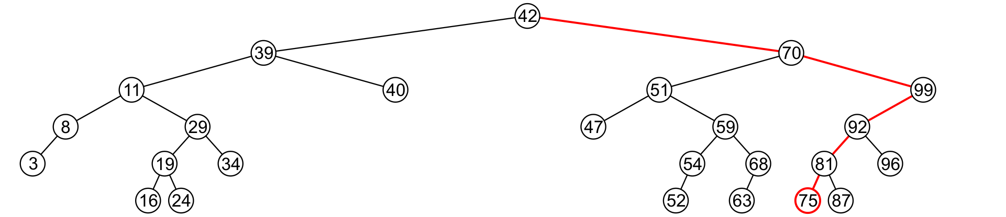
Deleting a Node – Leaf Node
Consider deleting node containing 75

Slide 26
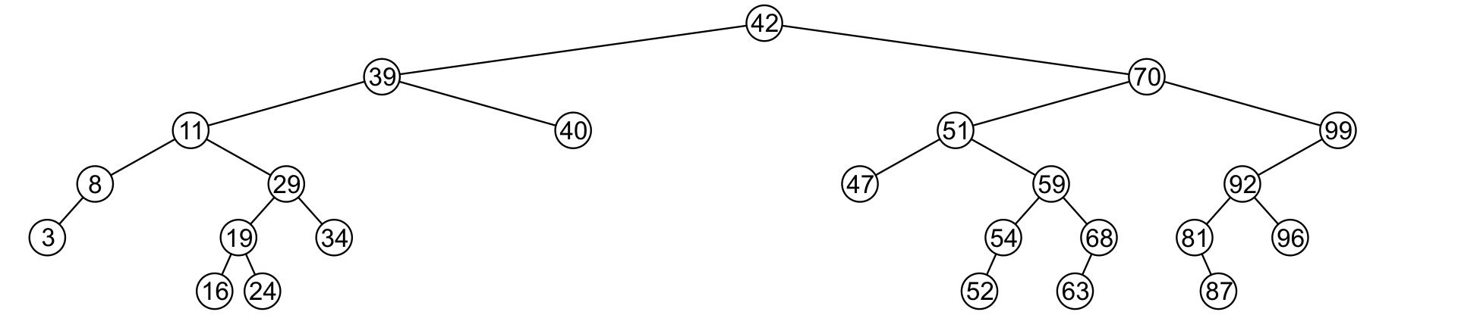
Deleting a Node – Leaf Node
Consider deleting node containing 75
The node is deleted and left child of 81 is set to NULL

Slide 27
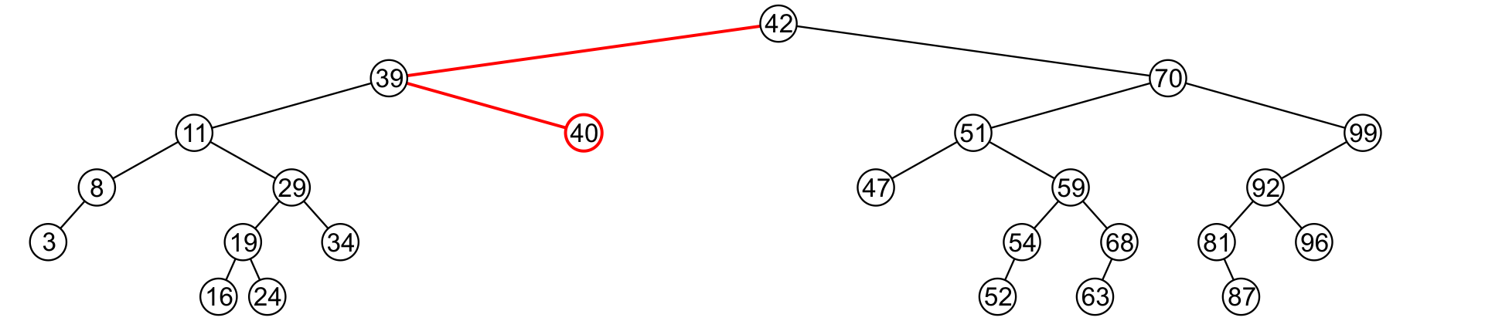
Deleting a Node – Leaf Node
Consider deleting node containing 40

Slide 28
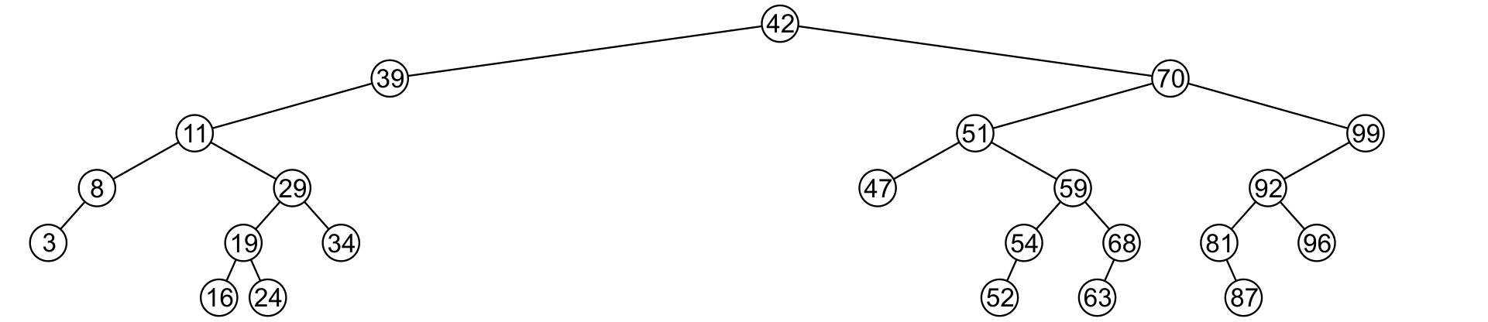
Deleting a Node – Leaf Node
Consider deleting node containing 40
Node is deleted and right child of 39 is set to NULL

Slide 29
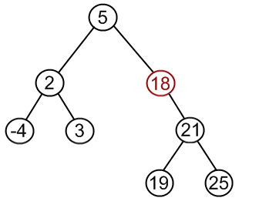
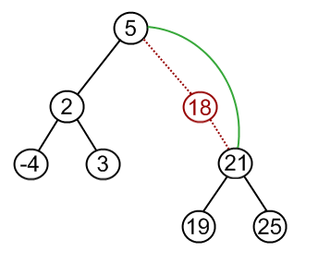
Deleting a Node – Node With Child
If a node has only one child (left or right)
Simply promote the subtree associated with the child
Consider deleting 18 which has one right child
Node 18 is deleted and right tree of node 5 is update to point to 21

Slide 30
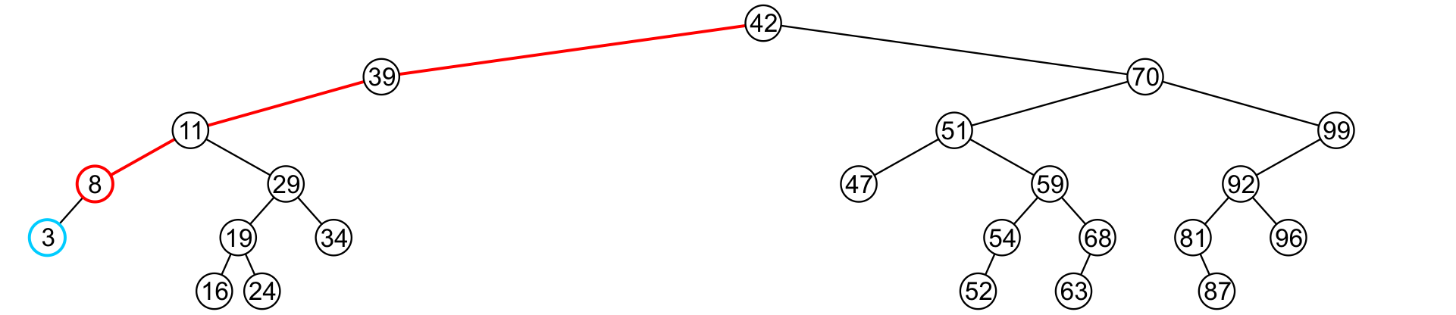
Deleting a Node – Node With Child
Consider deleting 8 which has one left child

Slide 31
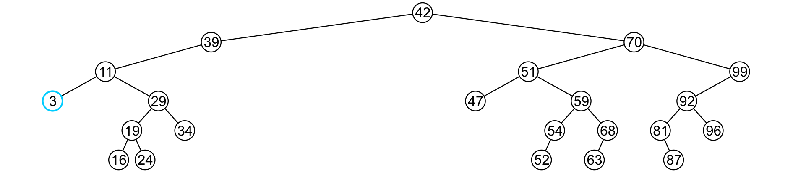
Deleting a Node – Node With Child
Consider deleting 8 which has one left child
Node 8 is deleted and the left tree of 11 is updated to point to 3

Slide 32
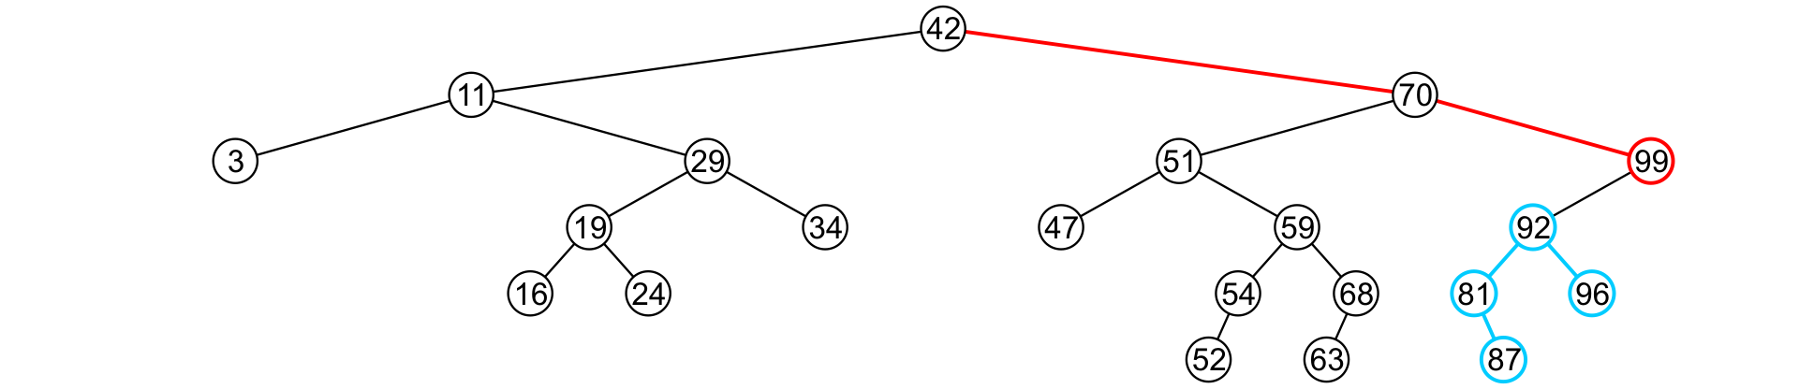
Deleting a Node – Node With Child
Consider deleting the node containing 99

Slide 33
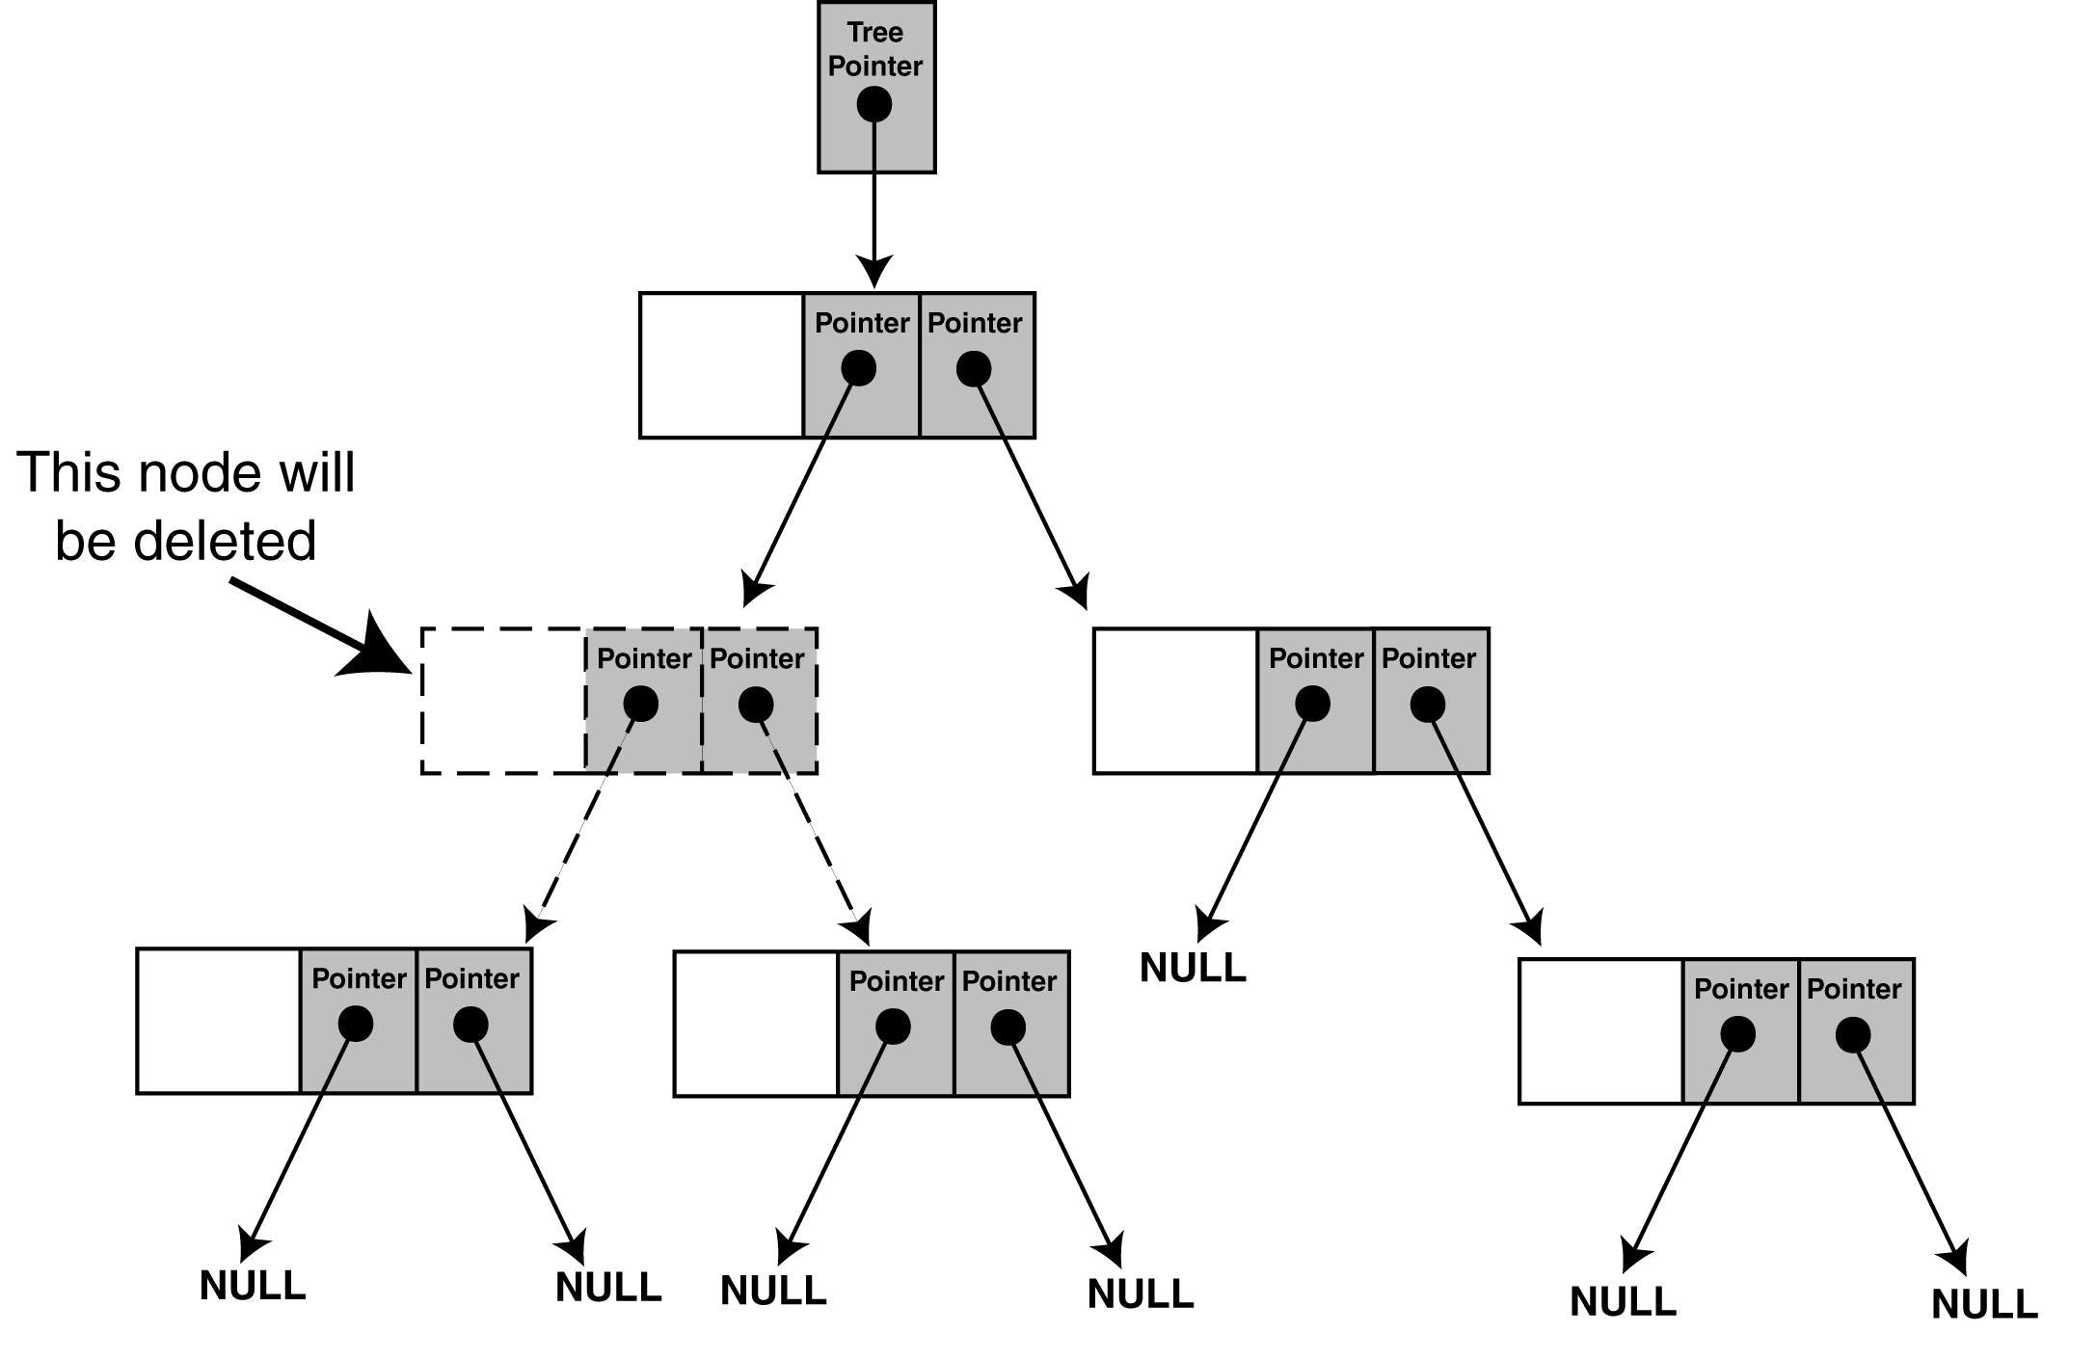
Deleting a Node – Node With Two Children
The problem is not as easily solved if the node has two children

Slide 34
Deleting a Node – Node With Two Children
Suppose node p with two children has to be deleted
Find a position in the right subtree of p to attach its left subtree
Left most node in the right subtree of node p
Attach the right subtree of node p to its parent
Consider deleting 10
10
30
30
10
25
45
25
45
5
30
5
5
Attach left subtree of 10 to that node, i.e., 25
Attach right subtree of 10 to its parent
2
25
45
2
2
Find left most node of right subtree of 10

Slide 35
Pointers Review
Pointer to Pointer versus reference to Pointer?
int g_One=1;
void func(int* pInt);
int main()
{
int nvar=2;
int* pvar=&nvar;
func(pvar);
std::cout<<*pvar<<std::endl;
return 0;
}
void func(int* pInt)
{
pInt=&g_One;
}
int g_One=1;
void func(int*& rpInt);
int main()
{
int nvar=2;
int* pvar=&nvar;
func(pvar);
std::cout<<*pvar<<std::endl;
return 0;
}
void func(int*& rpInt)
{
rpInt=&g_One;
}
Notes:
What will both programs print?
The first one makes a copy of the pointer
The second one modifies the actual pointer

Slide 36
Deleting a Node – Implementation
class IntBinaryTree { private: TreeNode *root; // Pointer to the root of BST
void destroySubTree(TreeNode *); //Recursively delete all tree nodes
void deleteNode(int, TreeNode *&); void makeDeletion(TreeNode *&); void displayInOrder(TreeNode *); void displayPreOrder(TreeNode *); void displayPostOrder(TreeNode *);
public:
IntBinaryTree() { root = NULL; } ~IntBinaryTree() { destroySubTree(root); } void insertNode(int); bool find(int); void remove(int num); { deleteNode( num, root)} void showNodesInOrder() { displayInOrder(root); } void showNodesPreOrder() { displayPreOrder(root); } void showNodesPostOrder() { displayPostOrder(root); } };
The argument passed to the remove function is the value of the node to be deleted.

Slide 37
Deleting a Node – Implementation
void IntBinaryTree::deleteNode(int num, TreeNode *&nodePtr) {
if (nodePtr == NULL) // node does not exist in the tree cout << num <<“ not found.\n";
else if (num < nodePtr->value)
deleteNode(num, nodePtr->left); // find in left subtree
else if (num > nodePtr->value) deleteNode(num, nodePtr->right); // find in right subtree
else // num == nodePtr->value i.e. node is found makeDeletion(nodePtr); // actually deletes node from BST
}
Note:
The declaration of the nodePtr parameter: TreeNode *&nodePtr;
nodePtr is a reference to a pointer to a TreeNode structure
Any action performed on nodePtr is actually performed on the argument passed into nodePtr

Slide 38
Deleting a Node – Implementation
void IntBinaryTree::makeDeletion(TreeNode *&nodePtr) { TreeNode *tempNodePtr; // Temperary pointer
if (nodePtr->right == NULL) { // case for leaf and one (left) child tempNodePtr = nodePtr; nodePtr = nodePtr->left; // Reattach the left child delete tempNodePtr; }
else if (nodePtr->left == NULL) { // case for one (right) child tempNodePtr = nodePtr; nodePtr = nodePtr->right; // Reattach the right child delete tempNodePtr; }
else { // case for two children. tempNodePtr = nodePtr->right; // Move one node to the right while (tempNodePtr->left) { // Go to the extreme left node tempNodePtr = tempNodePtr->left;
}
tempNodePtr->left = nodePtr->left; // Reattach the left subtree tempNodePtr = nodePtr; nodePtr = nodePtr->right; // Reattach the right subtree delete tempNodePtr;
} }

Slide 39
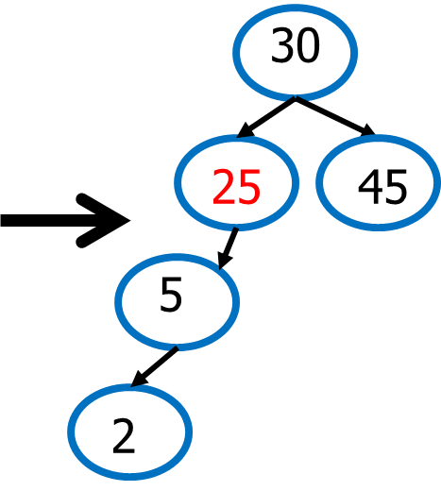
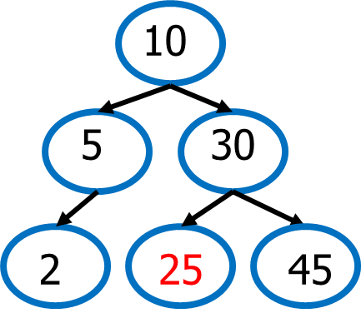
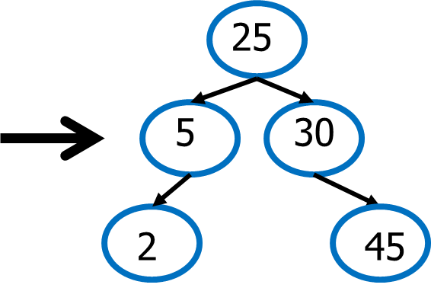
Deleting a Node – Node With Two Children
Problem: Height of the BST increases
A better Solution to delete node p with two children
Replace node p with the minimum object in the right subtree
Delete that object from the right subtree
Notes:
Note that you can also use the maximum object in the left sub-tree.
Leftmost node of the right subtree is actually its in-order successor (practically do an in-order traversal to establish this).
Another method of deleting node is to simply replace the node to be deleted with its in-order successor, then deleting the in-order successor.
(Question: will the minimum object in the right subtree always be the inorder successor of the node? Answer: yes. But for a node that has no right subtree, the inorder successor will be the nearest ancestor such that this node is in its left subtree)

Slide 40
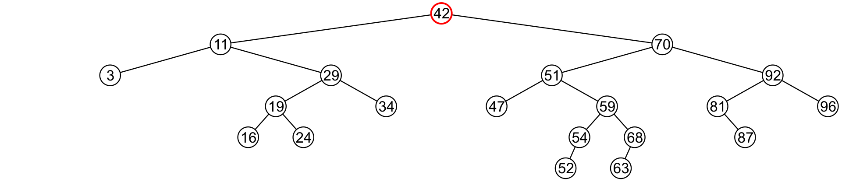
Deleting a Node Two Children – Better Solution
Consider the problem of deleting a full node, e.g., 42

Slide 41
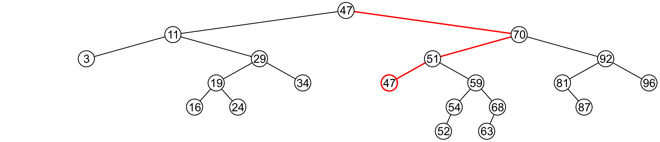
Deleting a Node Two Children – Better Solution
Consider the problem of deleting a full node, e.g., 42
Find minimum object in the right subtree, i.e., 47

Slide 42
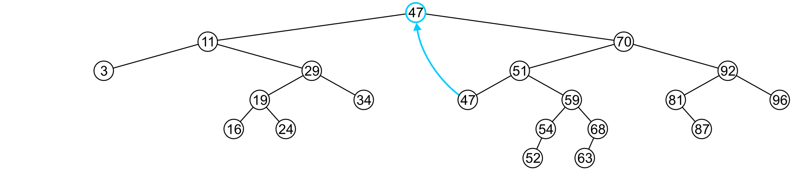
Deleting a Node Two Children – Better Solution
Consider the problem of deleting a full node, e.g., 42
Find minimum object in the right subtree, i.e., 47
Replace 42 with 47

Slide 43
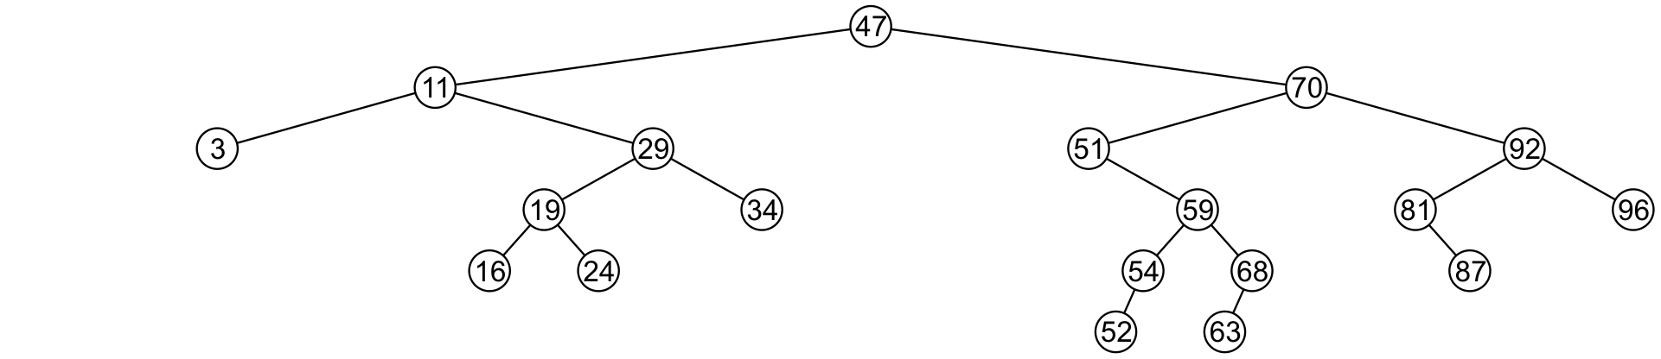
Deleting a Node Two Children – Better Solution
Consider the problem of deleting a full node, e.g., 42
Find minimum object in the right subtree, i.e., 47
Replace 42 with 47
Delete the leaf node 47

Slide 44
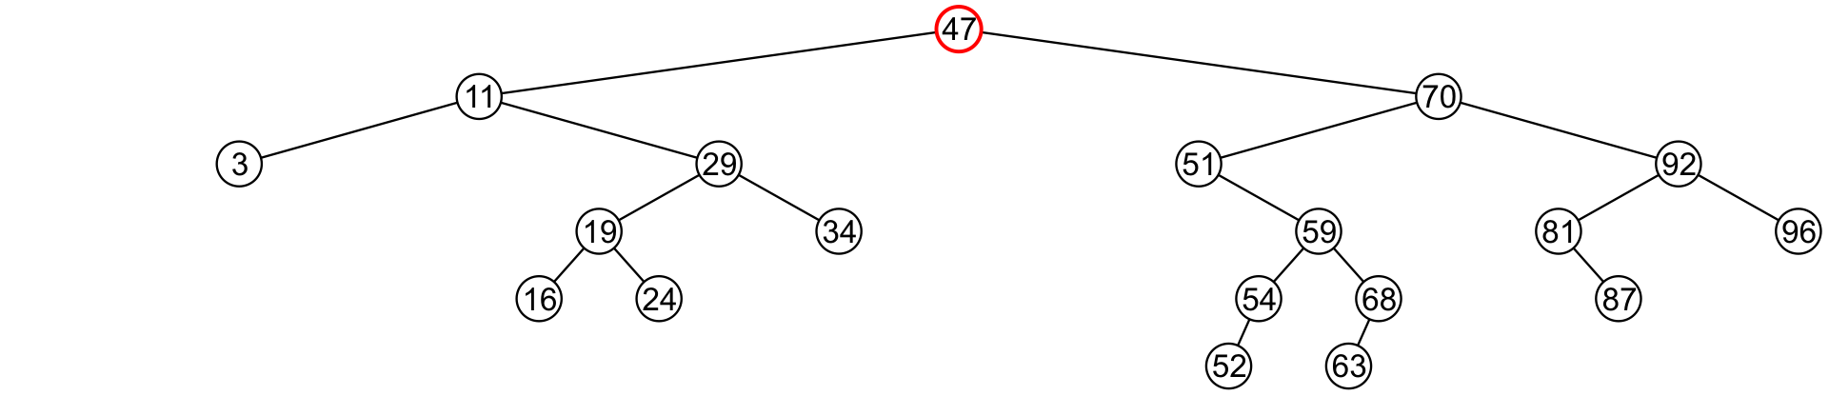
Deleting a Node Two Children – Better Solution
Consider the problem of deleting a full node, e.g., 47

Slide 45
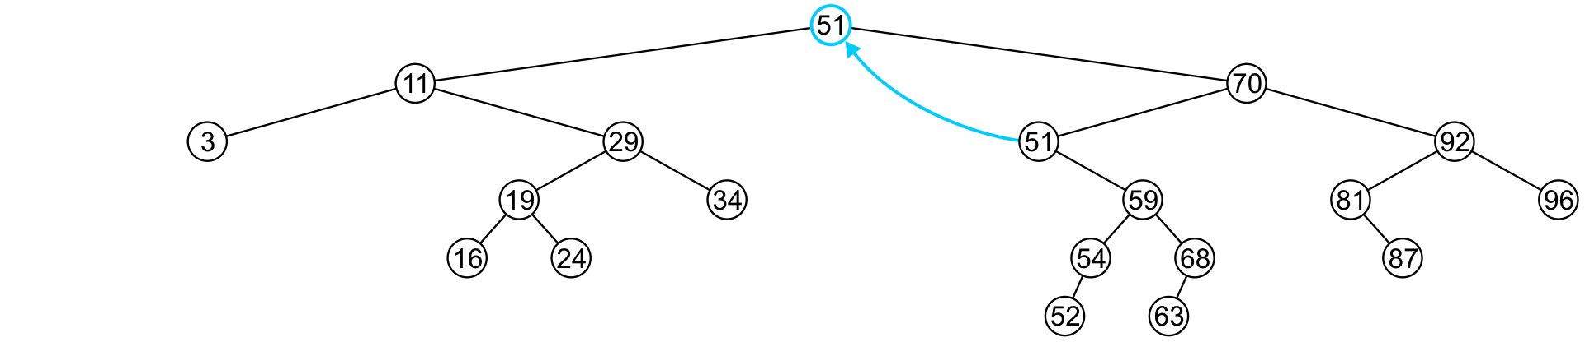
Deleting a Node Two Children – Better Solution
Consider the problem of deleting a full node, e.g., 47
Replace 47 with 51

Slide 46
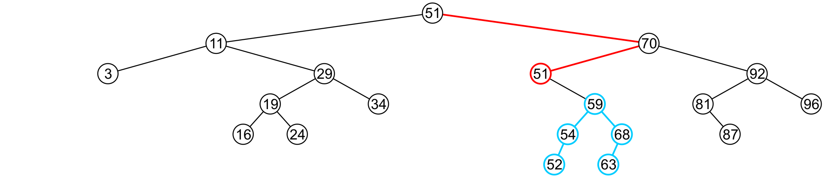
Deleting a Node Two Children – Better Solution
Consider the problem of deleting a full node, e.g., 47
Replace 47 with 51
Node 51 is not a leaf node

Slide 47
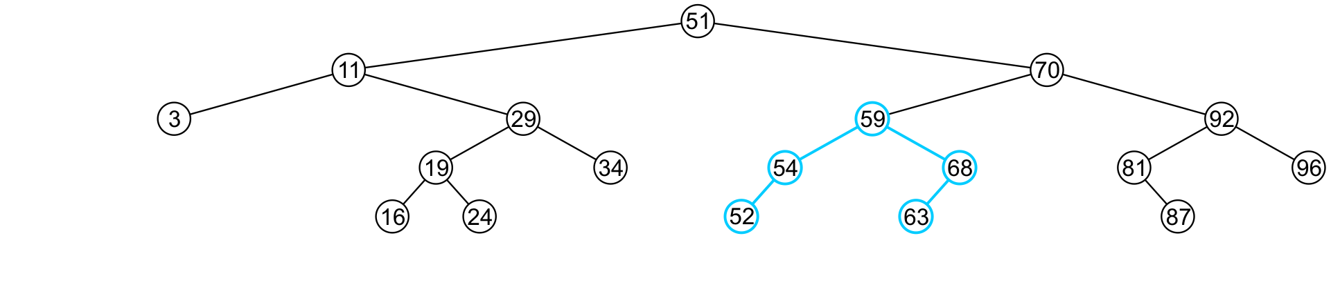
Deleting a Node Two Children – Better Solution
Consider the problem of deleting a full node, e.g., 47
Replace 47 with 51
Node 51 is not a leaf node
Assign the left subtree of 70 to point to 59

Slide 48
Using BST
// This program builds a binary tree with 5 nodes. // The DeleteNode function is used to remove two of them. #include <iostream.h> #include "IntBinaryTree.h“ void main(void) { IntBinaryTree tree; cout << "Inserting nodes.\n"; tree.insertNode(5); tree.insertNode(8); tree.insertNode(3); tree.insertNode(12); tree.insertNode(9); cout << "Here are the values in the tree:\n"; tree.showNodesInOrder();
cout << "Deleting 8...\n"; tree.remove(8); cout << "Deleting 12...\n"; tree.remove(12); cout << "Now, here are the nodes:\n"; tree.showNodesInOrder(); }
Program Output: Inserting nodes. Here are the values in the tree: 3 5 8 9 12

Slide 49
Using BST
// This program builds a binary tree with 5 nodes. // The DeleteNode function is used to remove two of them. #include <iostream.h> #include "IntBinaryTree.h“ void main(void) { IntBinaryTree tree; cout << "Inserting nodes.\n"; tree.insertNode(5); tree.insertNode(8); tree.insertNode(3); tree.insertNode(12); tree.insertNode(9); cout << "Here are the values in the tree:\n"; tree.showNodesInOrder();
cout << "Deleting 8...\n"; tree.remove(8); cout << "Deleting 12...\n"; tree.remove(12); cout << "Now, here are the nodes:\n"; tree.showNodesInOrder(); }
Program Output: Inserting nodes. Here are the values in the tree: 3 5 8 9 12 Deleting 8... Deleting 12... Now, here are the nodes: 3 5 9

Slide 50
Traversing a Binary Search Tree
class IntBinaryTree { private: TreeNode *root; // Pointer to the root of BST
void destroySubTree(TreeNode *); //Recursively delete all tree nodes
void deleteNode(int, TreeNode *&); void makeDeletion(TreeNode *&); void displayInOrder(TreeNode *); void displayPreOrder(TreeNode *); void displayPostOrder(TreeNode *);
public:
IntBinaryTree() { root = NULL; } ~IntBinaryTree() { destroySubTree(root); } void insertNode(int); bool find(int); void remove(int); { deleteNode( num, root); }
void showNodesInOrder() { displayInOrder(root); } void showNodesPreOrder() { displayPreOrder(root); } void showNodesPostOrder() { displayPostOrder(root); } };
Recursive implementation as discussed in the slides of Tree Traversal chapter.

Slide 51
Using BST
Program output:
Inserting nodes. Inorder traversal: 3 5 8 9 12
Preorder traversal: 5 3 8 12 9
Postorder traversal: 3
9 12 8 5
// This program builds a binary tree with 5 nodes. // The nodes are displayed with inorder, preorder, and postorder algorithms. #include <iostream.h> #include "IntBinaryTree.h“ void main(void) { IntBinaryTree tree; cout << "Inserting nodes.\n"; tree.insertNode(5); tree.insertNode(8); tree.insertNode(3); tree.insertNode(12); tree.insertNode(9);
cout << "Inorder traversal:\n"; tree.showNodesInOrder(); cout << "\nPreorder traversal:\n"; tree.showNodesPreOrder(); cout << "\nPostorder traversal:\n"; tree.showNodesPostOrder(); }

Slide 52
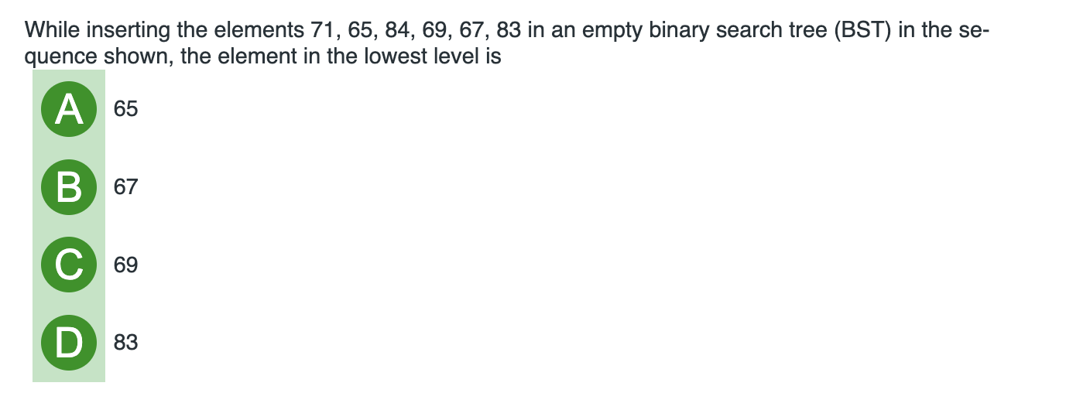
BST’s Practice

Slide 53
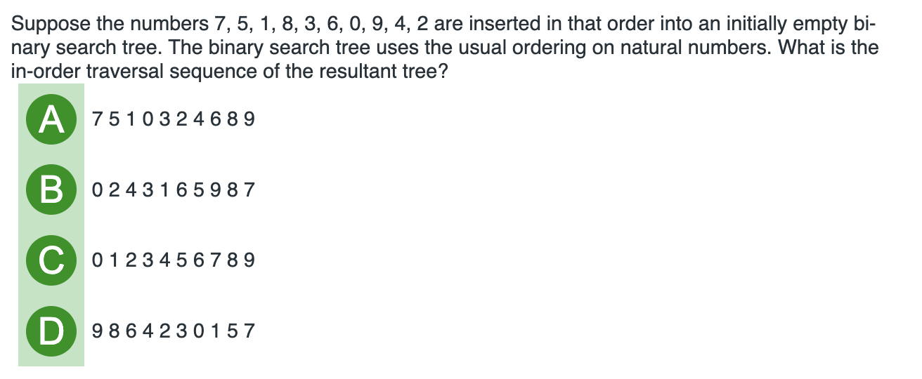
BST’s Practice

Slide 54
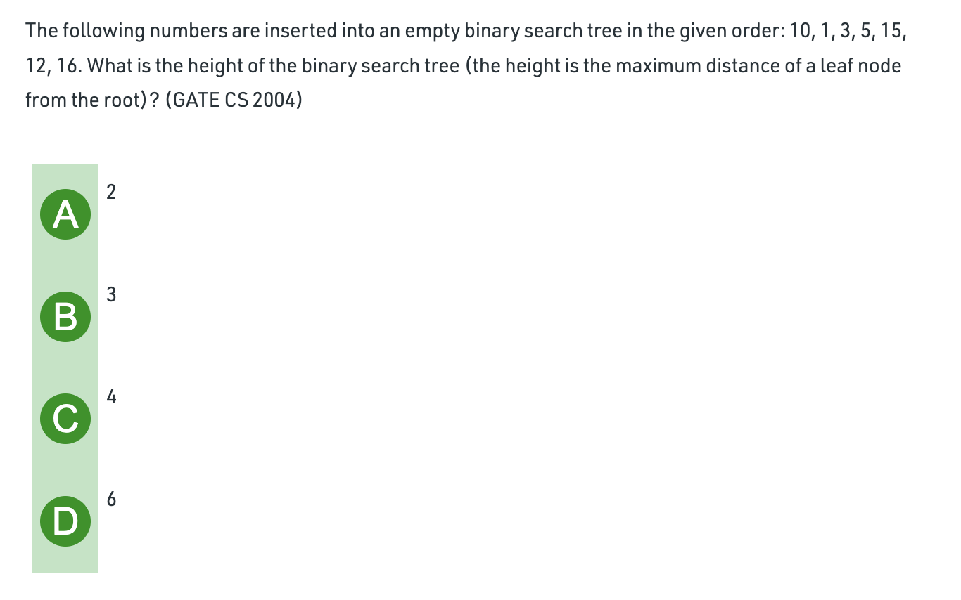
Notes:
Answer: B

Slide 55
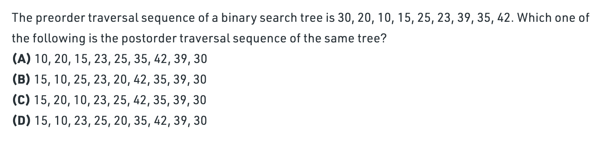
Constructing a Binary Search Tree Given its pre-order traversal
Notes:
Answer: D
How to construct binary search tree given its pre-order traversal?
https://www.geeksforgeeks.org/construct-bst-from-given-preorder-traversa/

Slide 56
Constructing a Binary Search Tree Given its postorder traversal
Construct a binary tree given its postorder traversal:
{1, 7, 5, 50, 40, 10}
Notes:
How? Last element is root, so the root is 10.
Look for the last value less than 10 : 5
Then look for last value less than 10: 7
Then 1.
Reverse them.
So 1, 7, 5 becomes the left subtree.
Now apply recursively same procedure to it. 5 becomes root, then 1 and 7 left and right.

Slide 57
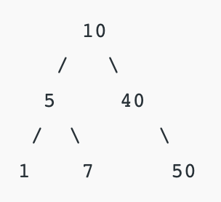
Answer to previous question will be:

Slide 58
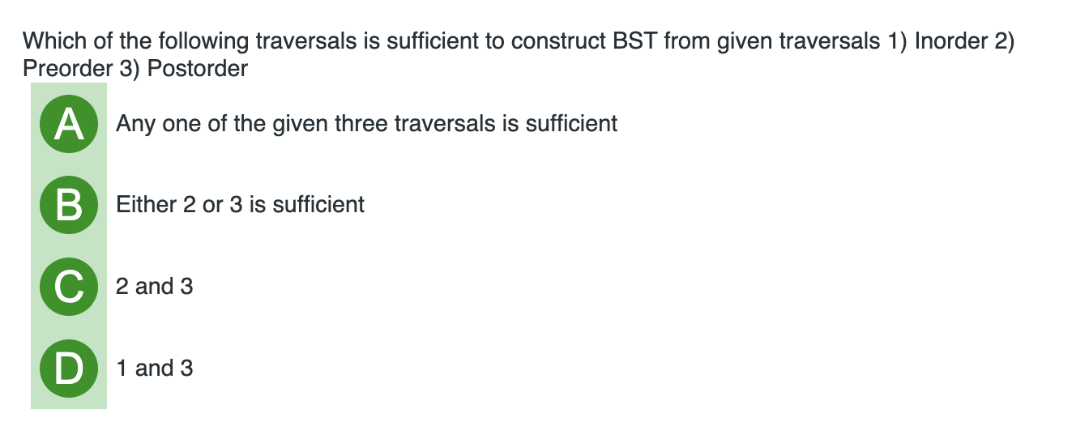
Can a specific tree be constructed from inorder traversal?
Notes:
Answer: B

Slide 59
Any Question So Far?

